Slide 1
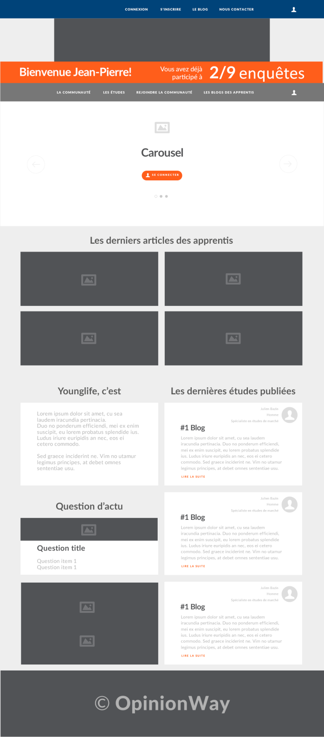
Same header as grandeconsultation
Logo (in production)
Menu with links to pages/sub pages
This is the only “private” element which appears only once logged in
It counts the number of surveys one has answered. There is an unique ID given on the survey side and we need a field in the database where I could write down this ID for every person so we have a link between survey and website
Same slider as Gdeconsultation : highcharts+ images
4 div to show the latest surveys + links to the pages : like on gdeconsultation
This is the new part.
We will have 10 maybe more bloggers and 3 spaces on the home page.
As soon as a blogger publish new article on his page, the oldest of the 3 div is changed for the new article.
Each div will content :
> Short blogger profile :
Blog of Marcin
4 pictos with information: Gender / Age / Job title / Size of his firm
> Title of the last article published
> Date of publication
> First line of his article with button “Click to read”
One the page “Les blogs” can you propose something to present the XX blogs and how we could surf from a blog to another?
Simple html like “Pourquoi nous rejoindre ?” on grandeconsultation
Question
2 banners”images”
More or less the same footer as grandeconsultation

